Slide 1


A Unified Framework for Medicinal Leaf Classification Using Deep Learning and Recommendation Using TF-IDF and Logistic Regression
Department of Information Technology
V R Siddhartha Engineering College
B.Tech in Information Technology
Major Project Review Presentation
Presented by
Ms. Tenia Kurapati (228W1A12G6)
Mr. Mallikharjuna Rao Ayinala (228W1A12D3)
Under the guidance of
Dr. T. Anuradha, Professor

Slide 2
Agenda
Introduction
Problem Statement
Objectives and Outcomes of the Project
Literature review & Summary
Datasets and Requirements
Algorithms used
Architecture Diagram
Implementation steps
Results obtained
Result analysis with charts
Conclusion and Future work
References

Slide 3
Introduction
Traditional medicinal knowledge is scattered and not easily accessible, making it difficult for users to utilize effectively.
Identifying medicinal plants manually is challenging due to similar leaf structures and lack of expertise.
Users typically search based on symptoms rather than plant names, creating a gap between identification and practical usage.
This project proposes a unified AI application where, I use Deep Learning (ResNet-50) plant identification(for learning about a unknown plant nature) and NLP (TF-IDF + Logistic Regression) for symptom-based recommendation.

Slide 4
Problem Statement
Medicinal plant identification is difficult for non-experts due to similar leaf features, leading to possible misclassification.
Incorrect identification may result in ineffective treatment or potential health risks.
Medicinal information is unstructured, scattered, and not easily accessible to common users.
Existing systems do not provide a unified solution combining image-based identification with symptom-based recommendation and structured outputs (usage, dosage, precautions).

Slide 5
Objectives
Outcomes
Develop a deep learning model (ResNet-50) for accurate medicinal leaf classification.
Build an NLP-based recommendation system (TF-IDF + Logistic Regression) for symptom-based leaf prediction.
Integrate both models into a unified, real-time mobile application with backend deployment.
Achieved a highly accurate system for both leaf classification and disease-based recommendation.
Developed a unified AI platform supporting image input and symptom-based queries.
Created a user-friendly mobile application providing usage, dosage, and precautions.

Slide 6
Literature Survey
Paper Title | Year | Work Done | Algorithms Used | Datasets Used | Limitations | Conclusion
Deep Residual Learning for Image Recognition | 2024 | Proposed residual learning framework to train very deep neural networks effectively and solve degradation problem. | ResNet (Residual CNN Architecture) | ImageNet Dataset (ILSVRC) | High computational cost and requires large training data | Residual networks significantly improve accuracy and enable deeper architectures for image classification tasks.
Comparative Analysis of TF-IDF and Word2Vec in Sentiment Analysis: A Case of Food Reviews | 2025 | Compared TF-IDF and Word2Vec text representation methods for sentiment analysis on large-scale food review data using logistic regression. | TF-IDF, Word2Vec (feature extraction) and Logistic Regression (classification model). | Kaggle food reviews dataset with ~560,000 reviews containing ratings and text | TF-IDF suffers from overfitting and lacks semantic understanding; Word2Vec requires large data and computational resources. | TF-IDF achieves high training accuracy but overfits, while Word2Vec provides better generalization and is more suitable for large datasets.

Slide 7
Literature Survey
ResNet: Enabling Deep Convolutional Neural Networks through Residual Learning | 2025 | Evaluated ResNet performance and demonstrated improved training stability and accuracy using residual connections. | ResNet (Residual Learning with Skip Connections) | CIFAR-10 Dataset | Still requires optimization techniques and high resources for large-scale tasks | ResNet enables efficient training of deep networks and achieves higher accuracy compared to traditional CNNs.
Automatic Classification of Pathology Reports using TF-IDF Features | 2023 | TF-IDF for extracting features from medical reports and classifying them using ML models. | TF-IDF + SVM, XGBoost, Logistic Regression | Pathology Reports Dataset (NCI dataset, 1,949 reports) | Performance depends on preprocessing and lacks contextual understanding | TF-IDF effectively highlights important keywords and supports accurate medical text classification.

Slide 8
Dataset & Requirements
Dataset 1: Indian Medicinal Leaf Image Dataset (image folders by species).
Dataset 2: Text/CSV dataset containing identified image and medicinal properties mapping.
Dataset 3: Custom Disease – Leaf Dataset (CSV Format) - Fields : Disease, Symptoms, Leaf name , Usage, Dosage, Precautions.
- 30 – 50 diseases mapped to corresponding medicinal leaves
Requirements:
Programming: Python
Libraries: pandas, numpy, scikit – learn, PyTorch
Training Environment: CPU -TF IDF,GPU- ResNet50
Backend API :
Framework : FastAPI
Mobile App : Expo React Native

Slide 9
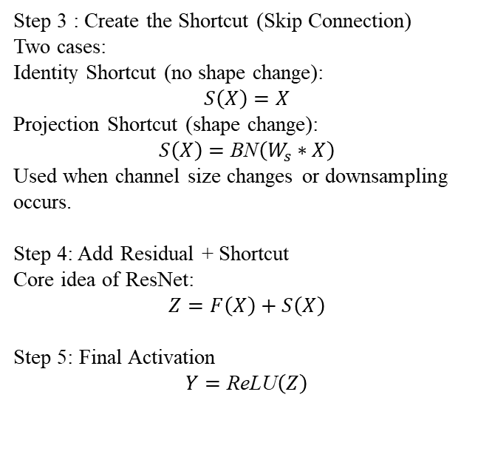
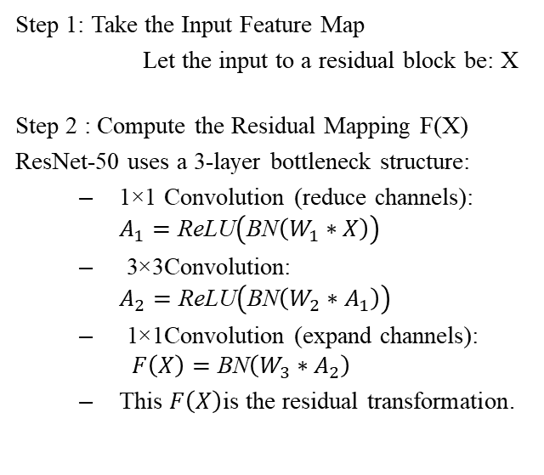
Algorithms Used
ResNet-50 (Residual Network - 50 Layers)
Step 3 : Create the Shortcut (Skip Connection)
Two cases:
Identity Shortcut (no shape change): $$S\left(X\right)=X$$
Projection Shortcut (shape change): $$S\left(X\right)=\text{BN}\left(W_{s}∗X\right)$$
Used when channel size changes or downsampling occurs.
Step 4: Add Residual + Shortcut
Core idea of ResNet: $$Z=F\left(X\right)+S\left(X\right)$$
Step 5: Final Activation
$$Y=\text{ReLU}\left(Z\right)$$
Step 1: Take the Input Feature Map
Let the input to a residual block be: X
Step 2 : Compute the Residual Mapping F(X)
ResNet-50 uses a 3-layer bottleneck structure:
1×1 Convolution (reduce channels): $A_{1}=\text{ReLU}\left(\text{BN}\left(W_{1}∗X\right)\right)$
3×3 Convolution: $A_{2}=\text{ReLU}\left(\text{BN}\left(W_{2}∗A_{1}\right)\right)$
1×1 Convolution (expand channels): $F\left(X\right)=\text{BN}\left(W_{3}∗A_{2}\right)$
This $F\left(X\right)$is the residual transformation.

Slide 10



TF – IDF (Term Frequency – Inverse Document Frequency)
Step 1 : Take Input Text Document
Let the input document be: D
Step 2 : Compute Term Frequency (TF)
For term 𝑡 in document 𝐷:
Where:
N = Total number of documents
df(t) = Number of documents containing term t
Step 4: Compute TF-IDF Score
This converts text into numerical feature vector
Step 3 : Compute Inverse Document Frequency (IDF)

Slide 11



Logistic Regression (Multi – Class Classification)
Step 1: Take Feature Vector
Let TF-IDF vector be: X Step 2 : Compute Linear Combination
This computes probability for each leaf class.
Step 4 : Final Prediction
Where W = Weight vector b = bias
Step 3 : Apply Softmax function (Multi – class)
Select class with highest probability.

Slide 12
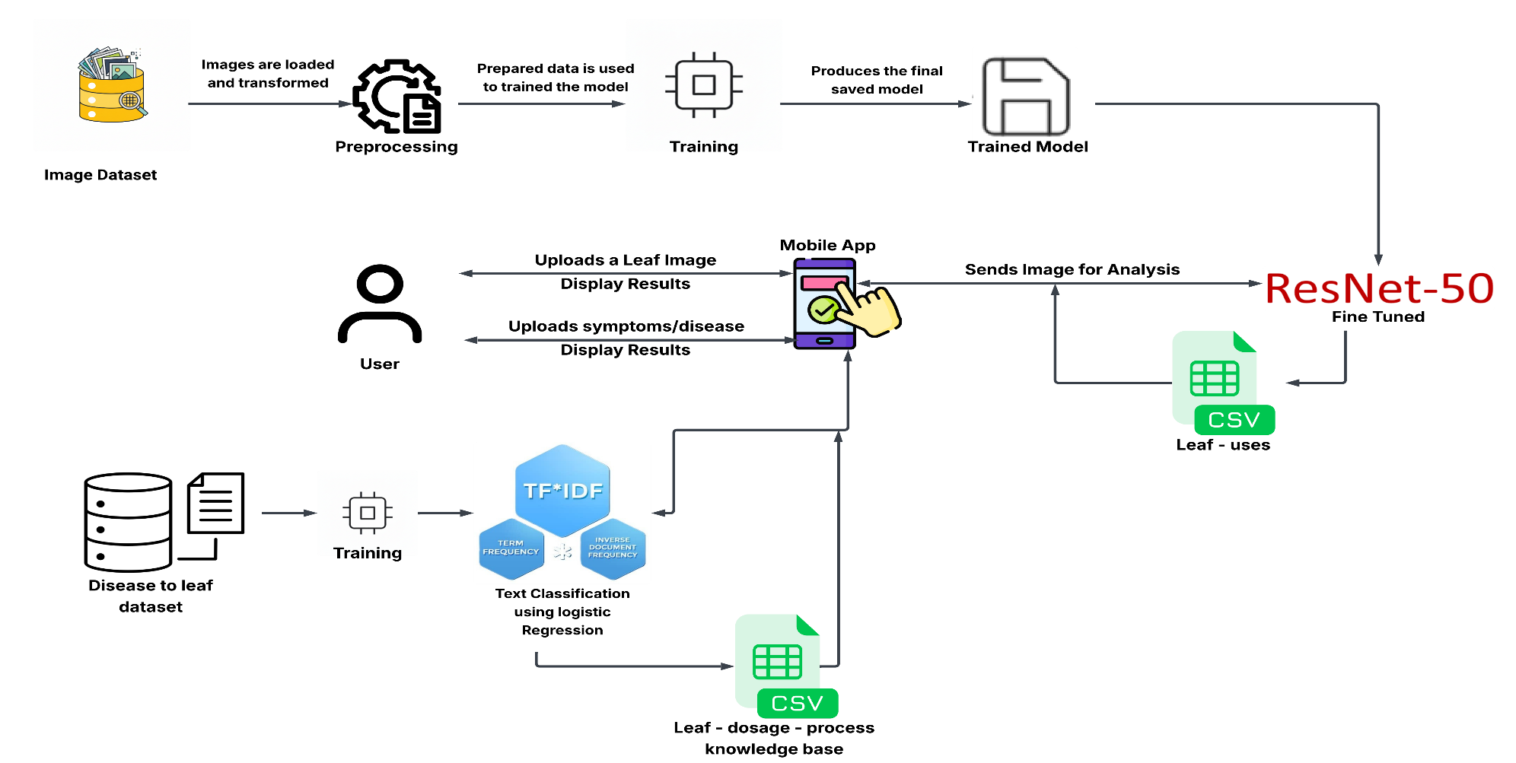
Architecture Diagram

Slide 13
Implementation Steps
4. Model Training
Trained models using:
Cross-Entropy Loss (ResNet)
Multi-class classification (Logistic Regression)
Evaluated using accuracy and loss metrics
5. Backend Development
Built APIs using FastAPI
Created endpoints:
/predict-image
/predict-text
Returned structured JSON output
6. Deployment
Deployed backend on Hugging Face Spaces
Stored trained models:
.pth (ResNet)
.pkl (TF-IDF + Logistic Regression)
7. Mobile Application
Developed using React Native (Expo)
Features:
Image upload
Symptom input (chat-like)
Real-time results display
1. Data Collection
Collected Indian Medicinal Leaf Image Dataset (80 species)
Created Custom Disease–Leaf Dataset (CSV) with:
Disease, Symptoms, Leaf Name, Usage, Dosage, Precautions
2. Data Preprocessing
Images:
Resized to 224 × 224
Normalization (ImageNet standards)
Data augmentation (flip, rotation)
Text:
Lowercasing
Stopword removal
Punctuation removal
3. Model Development
Image Classification Model:
Used ResNet-50 (Transfer Learning)
Fine-tuned final layers for 80 classes
NLP Recommendation Model:
Applied TF-IDF vectorization
Trained Logistic Regression classifier

Slide 14
Execution Flow
Step 4: Information Retrieval
Fetch from dataset:
Usage
Dosage
Precautions
Step 5: Response Generation
Output sent via API
Displayed in mobile app
Step 6: Stateless Interaction
No previous data stored
Each query handled independently
Step 1: User Input
User provides:
Leaf image OR
Symptoms/disease text
Step 2: Input Processing
Image → Preprocessed → ResNet model
Text → Cleaned → TF-IDF vectorized
Step 3: Model Prediction
ResNet → Predicts leaf class
NLP model → Predicts top 3 recommended leaves

Slide 15
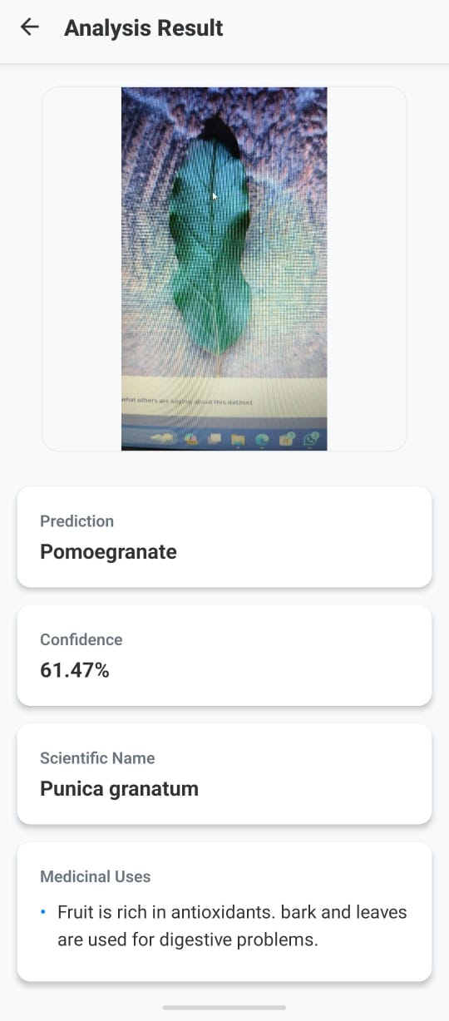
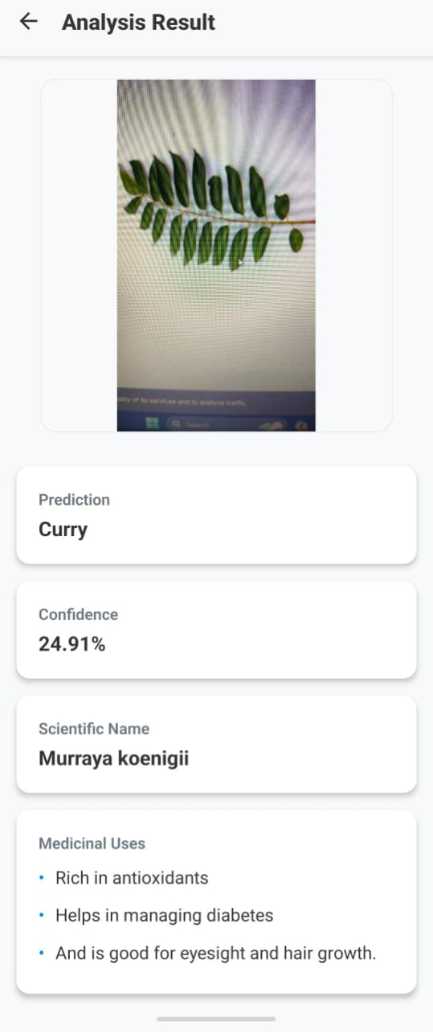
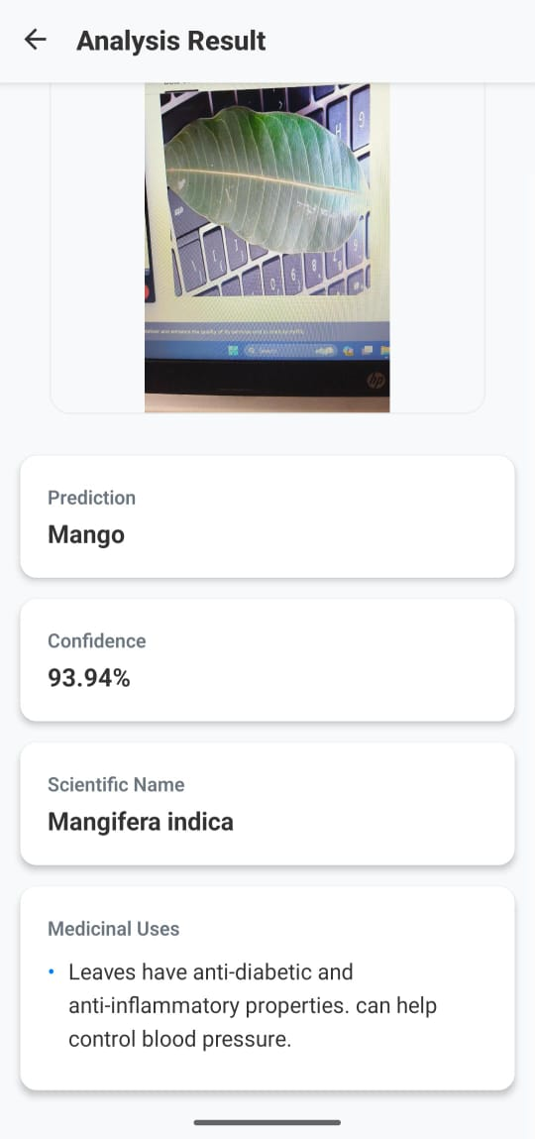
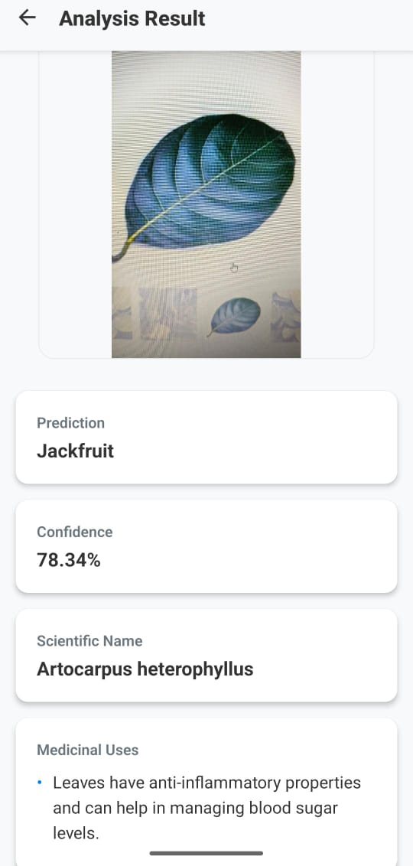
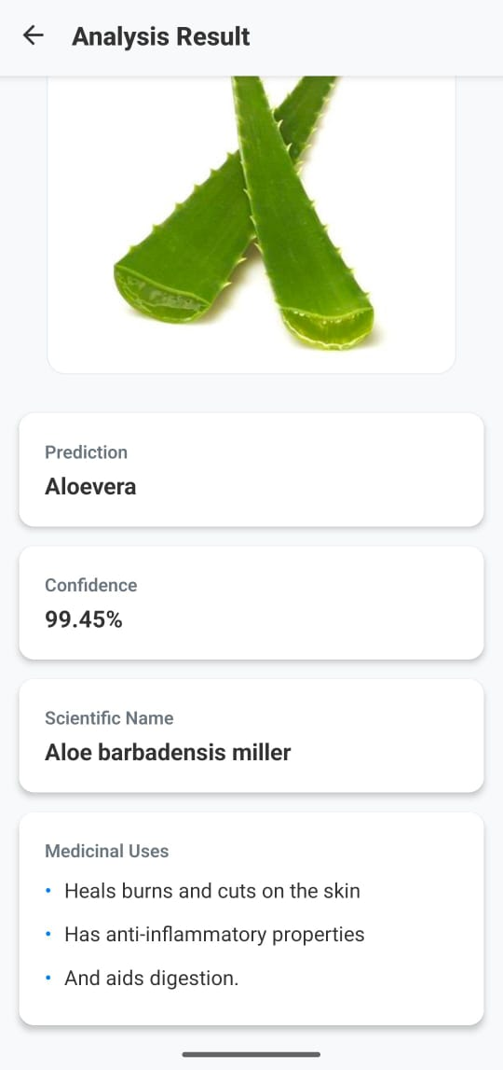
Results obtained from Leaf Classifier :

Slide 16
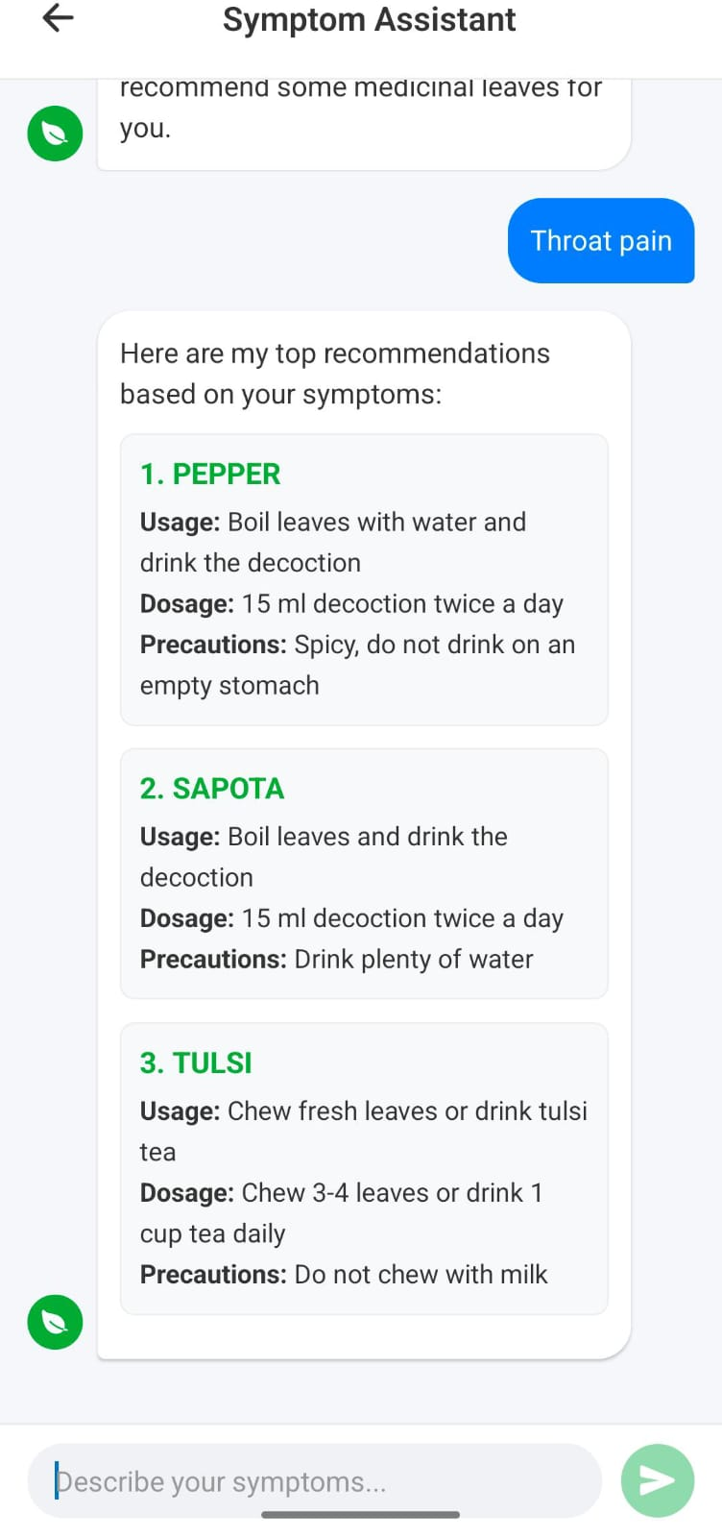
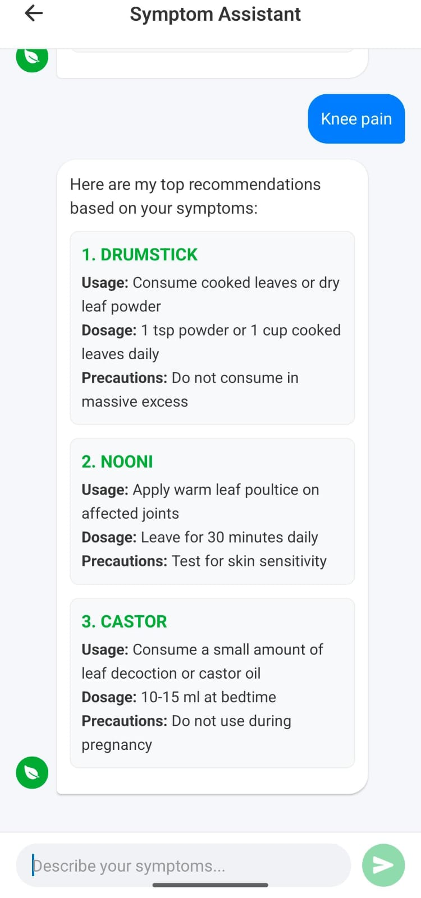
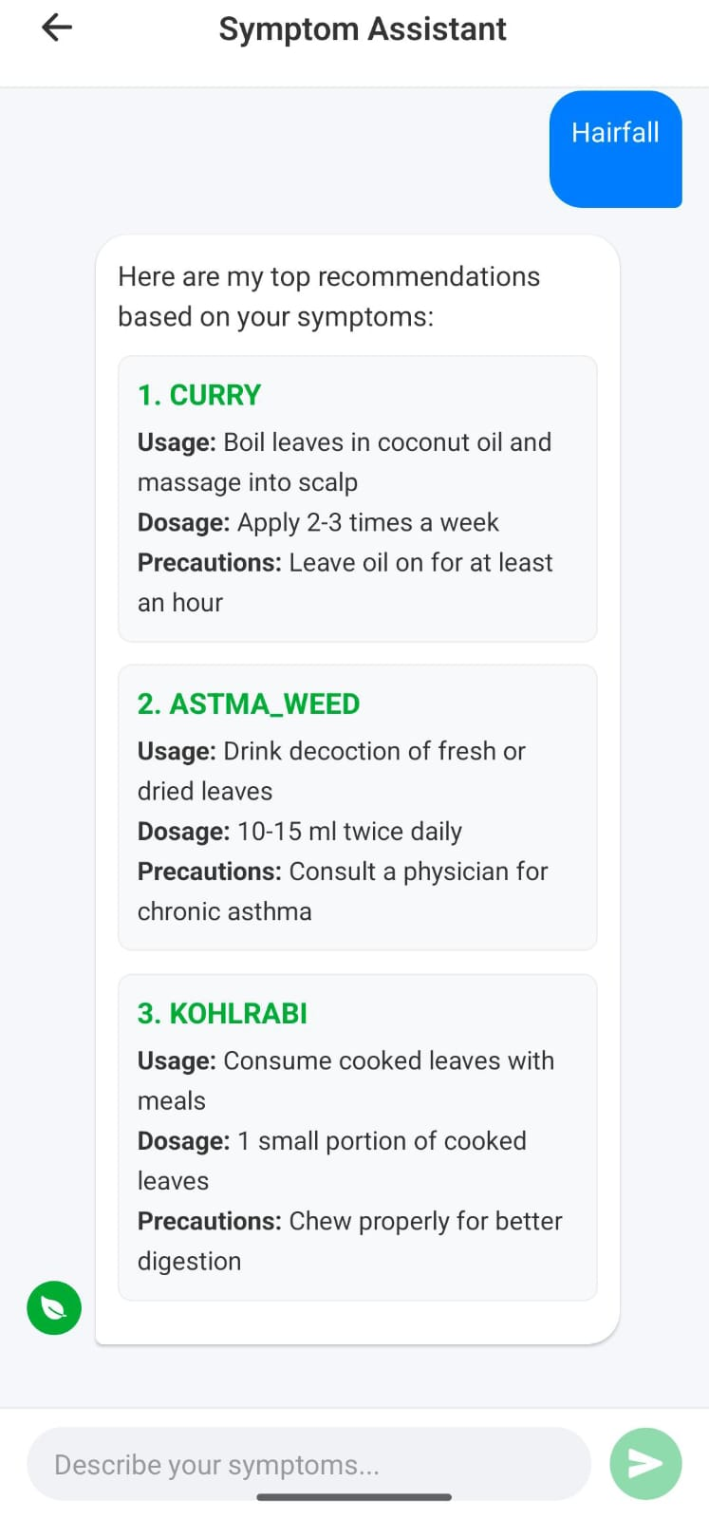
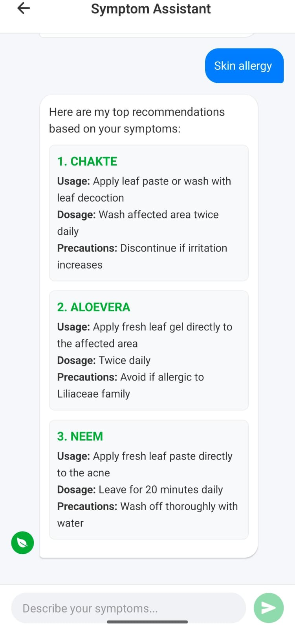
Results Obtained From Symptom Asst:

Slide 17
Results Analysis
Accuracy Graph of ResNET 50
Loss curve of ResNET 50

Slide 18
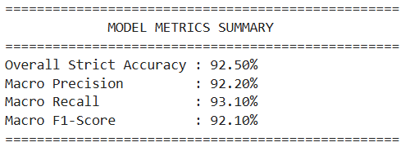
Results Analysis
Model Metrics of TF-IDF
Confusion matrix of ResNet50

Slide 19
Conclusion and Future Work
Developed a unified AI system integrating Deep Learning (ResNet-50) and NLP (TF-IDF + Logistic Regression).
Achieved accurate leaf classification and symptom-based recommendation with structured outputs.
Successfully deployed as a real-time mobile application with FastAPI backend.
Bridges the gap between traditional medicinal knowledge and modern AI technology.
Future work includes using advanced NLP models (BERT, Word2Vec) for improved understanding.
Plan to expand dataset and add multilingual/voice support for better accessibility and real-world usage.

Slide 20
References
[1] K. He, X. Zhang, S. Ren, and J. Sun, “Deep Residual Learning for Image Recognition,” Proc. IEEE CVPR, 2024.
[2] J. Wäldchen and P. Mäder, “Plant Species Identification Using Computer Vision Techniques: A Systematic Literature Review,” ACM Computing Surveys, 2025.
[3] K. Kowsari et al., “A Comparative Study on TF-IDF Feature Weighting Method and its Analysis using Unstructured Dataset,” Proc. COLINS, 2025.
[4] Z. Zhan et al., “Comparative Analysis of TF-IDF and Word2Vec in Sentiment Analysis: A Case of Food Reviews,” ITM Web of Conferences, 2024.
[5] Z. Liang et al., “Robust Sentiment and Semantic Analysis of Small and Medium-Sized News Headline Datasets,” IEEE Access, 2026.

Slide 21
THANK YOU

